Slide 1

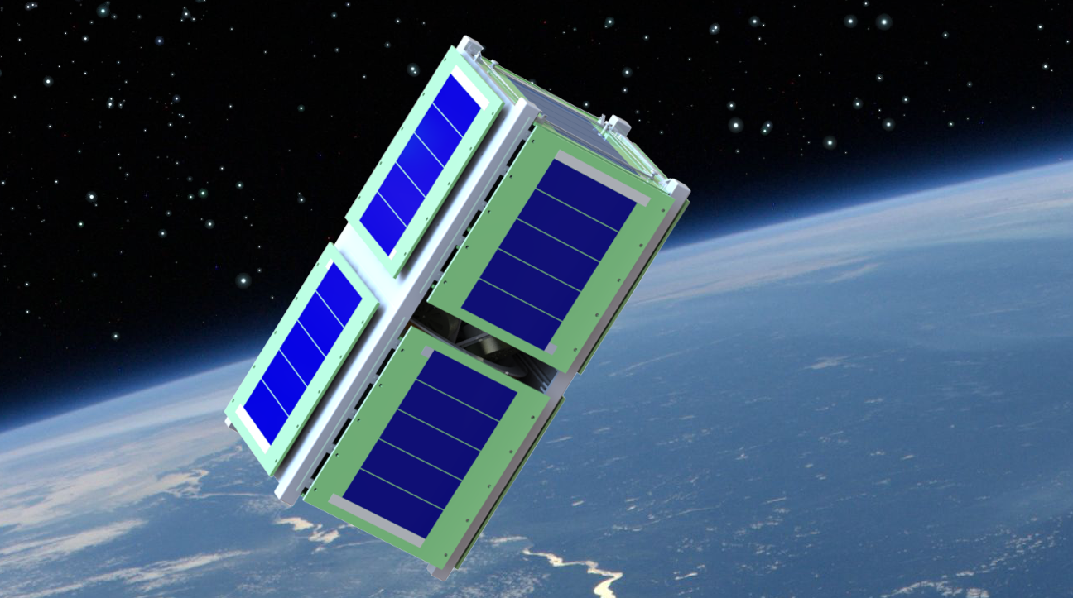
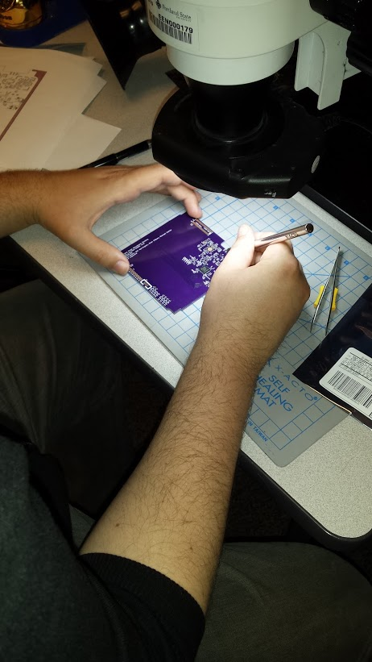
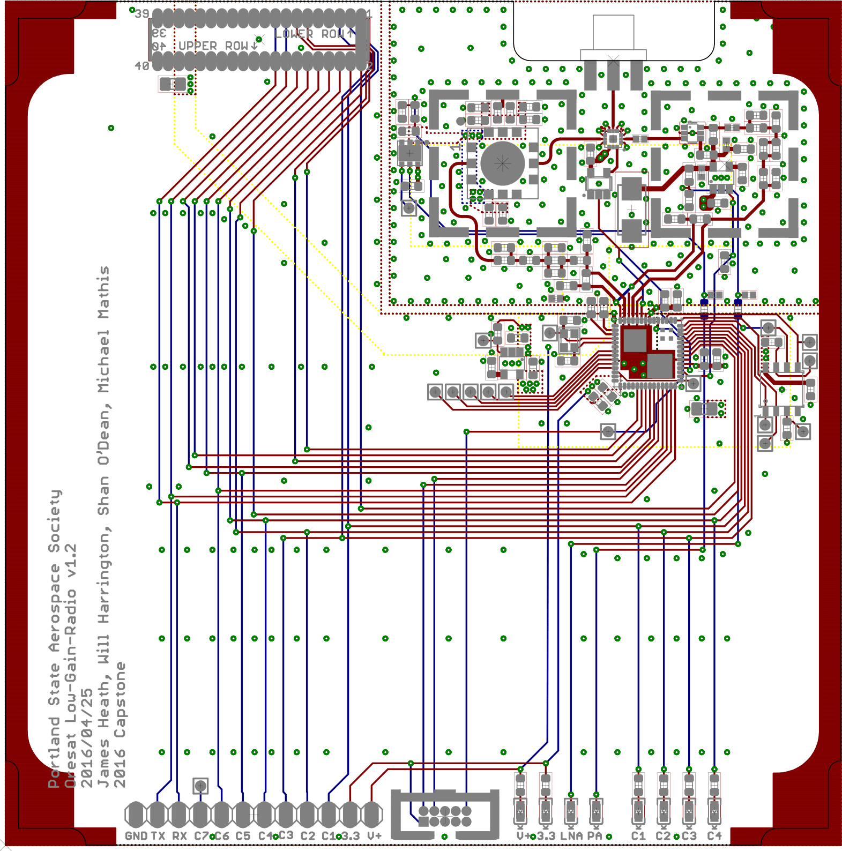
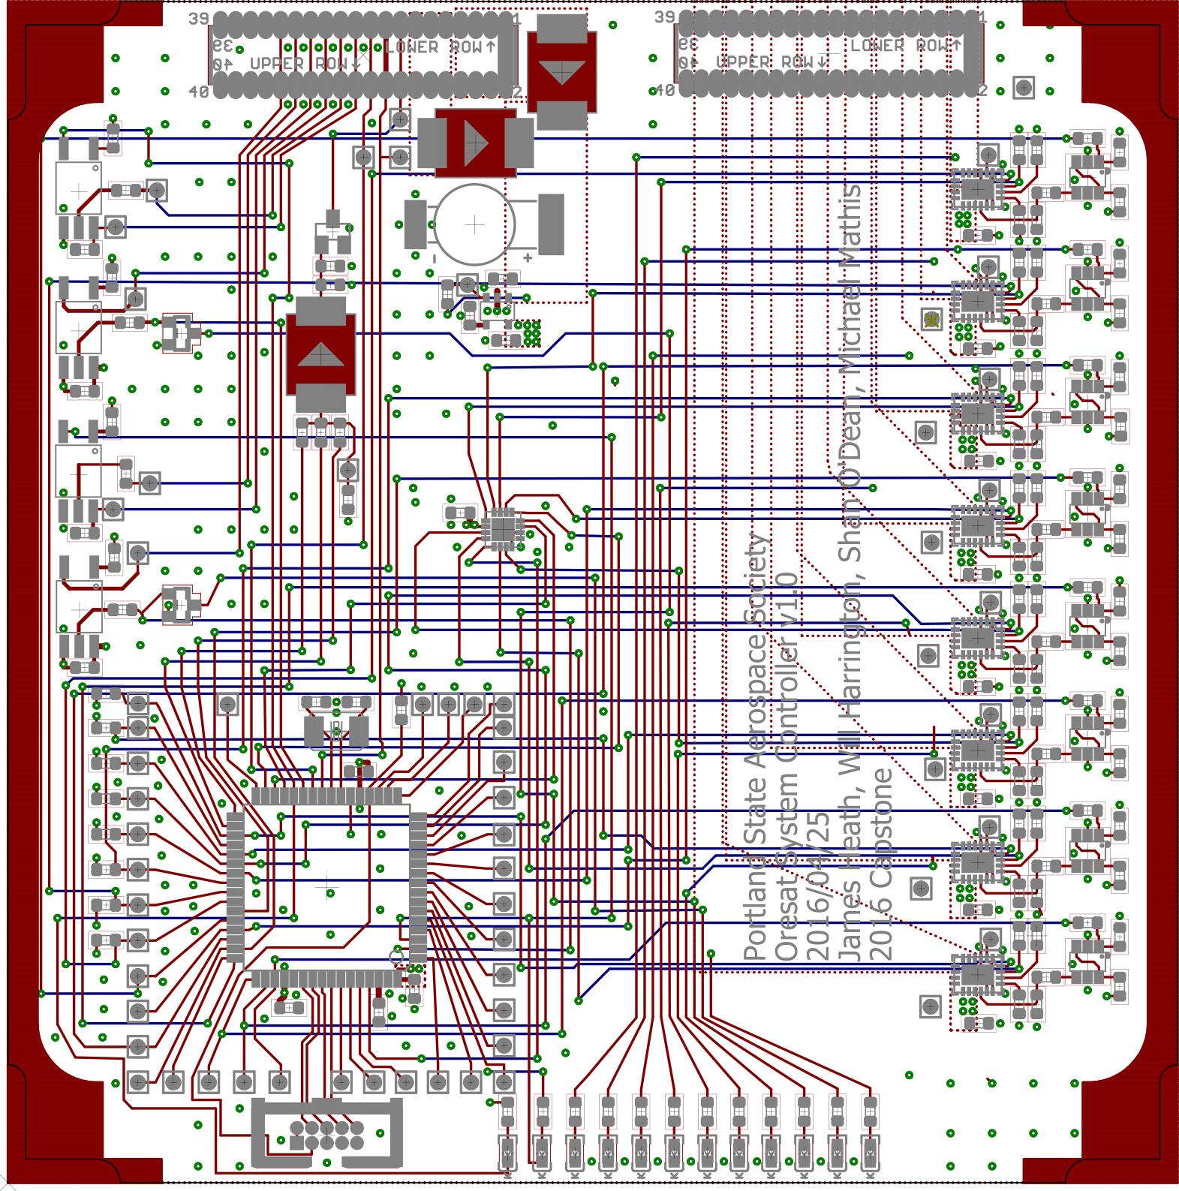
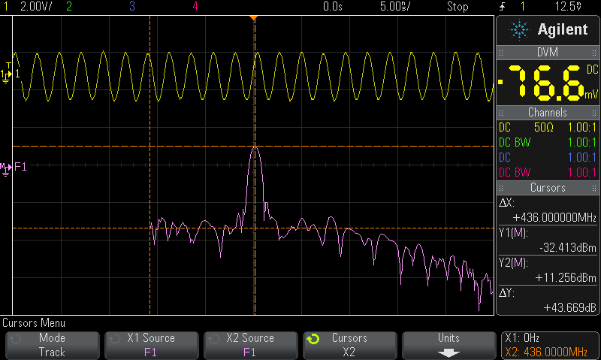
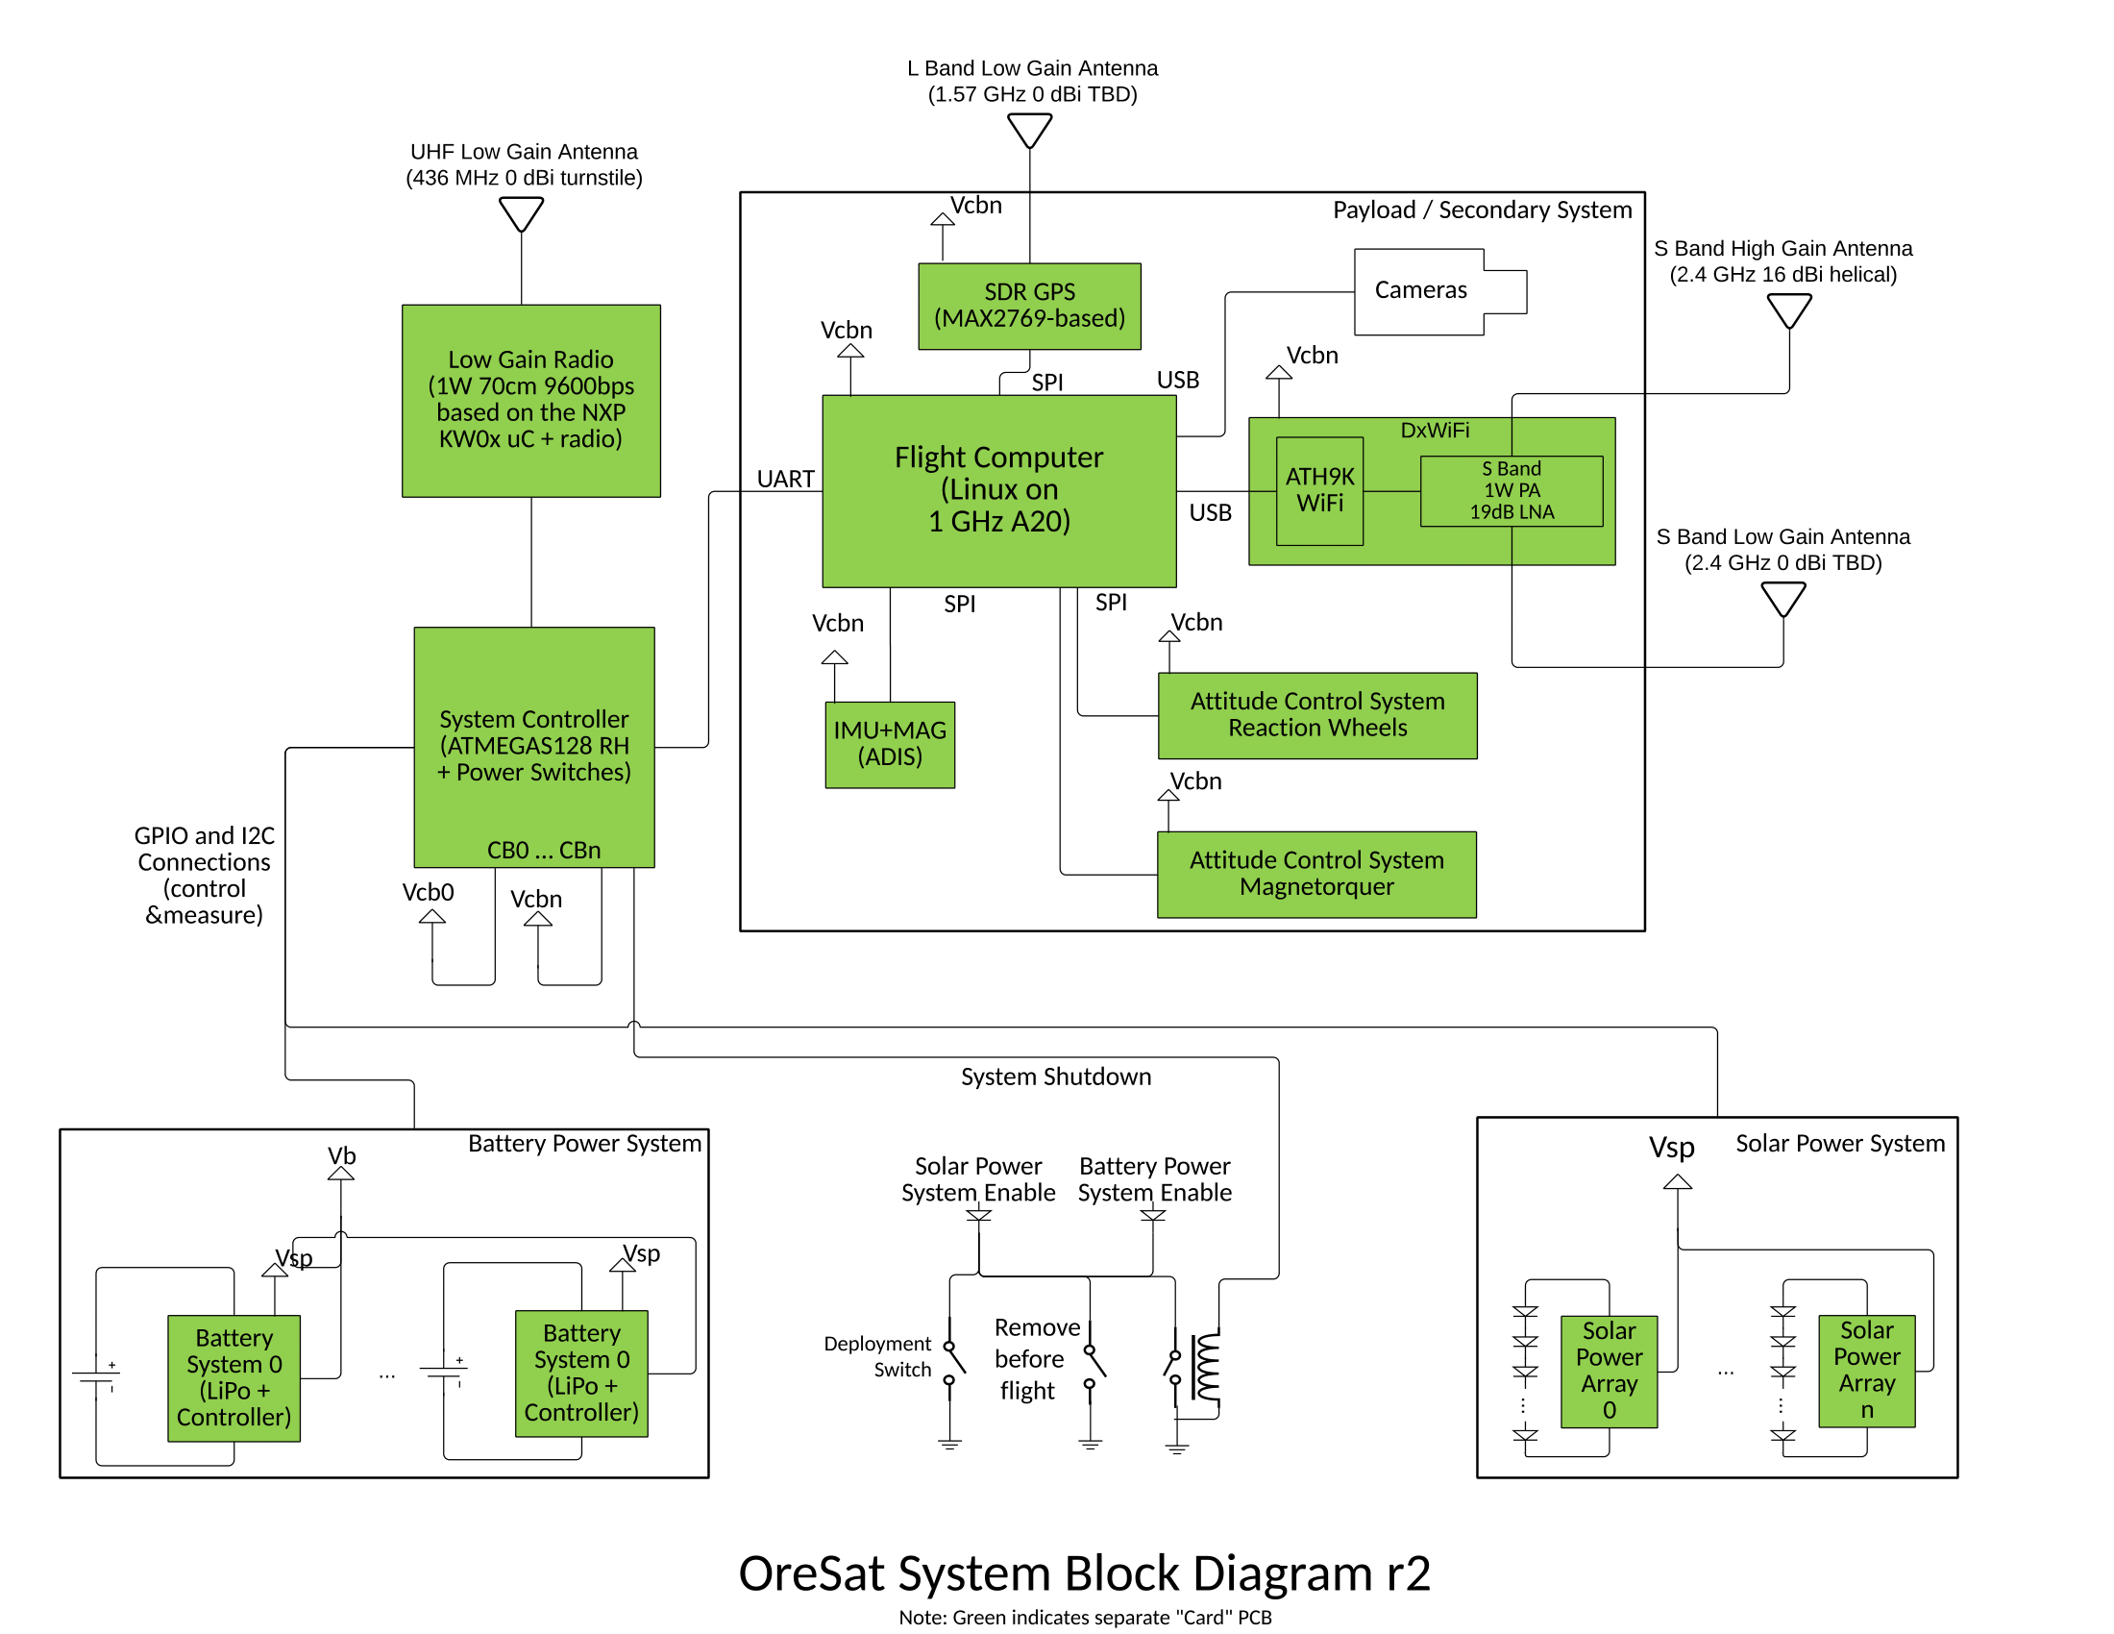
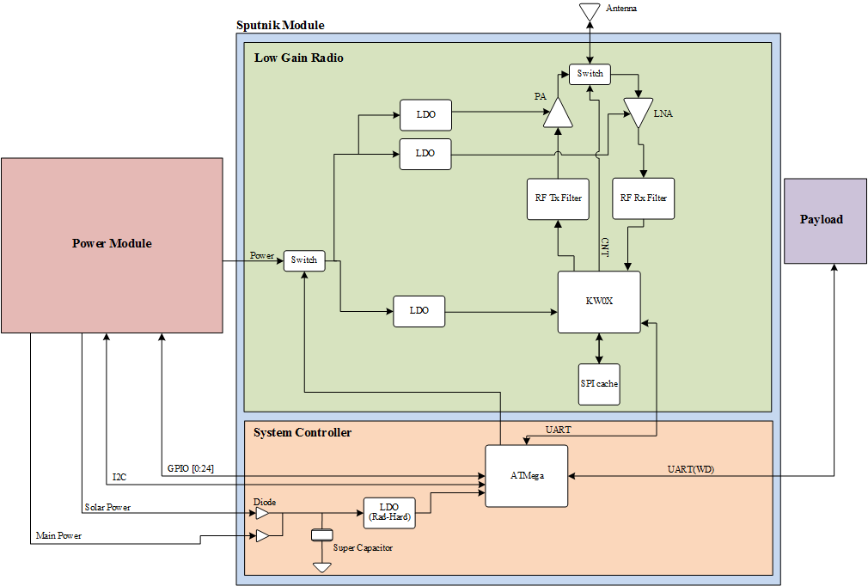
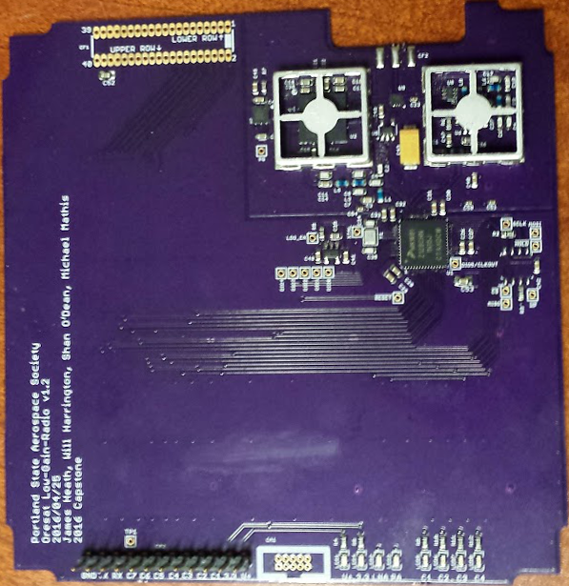
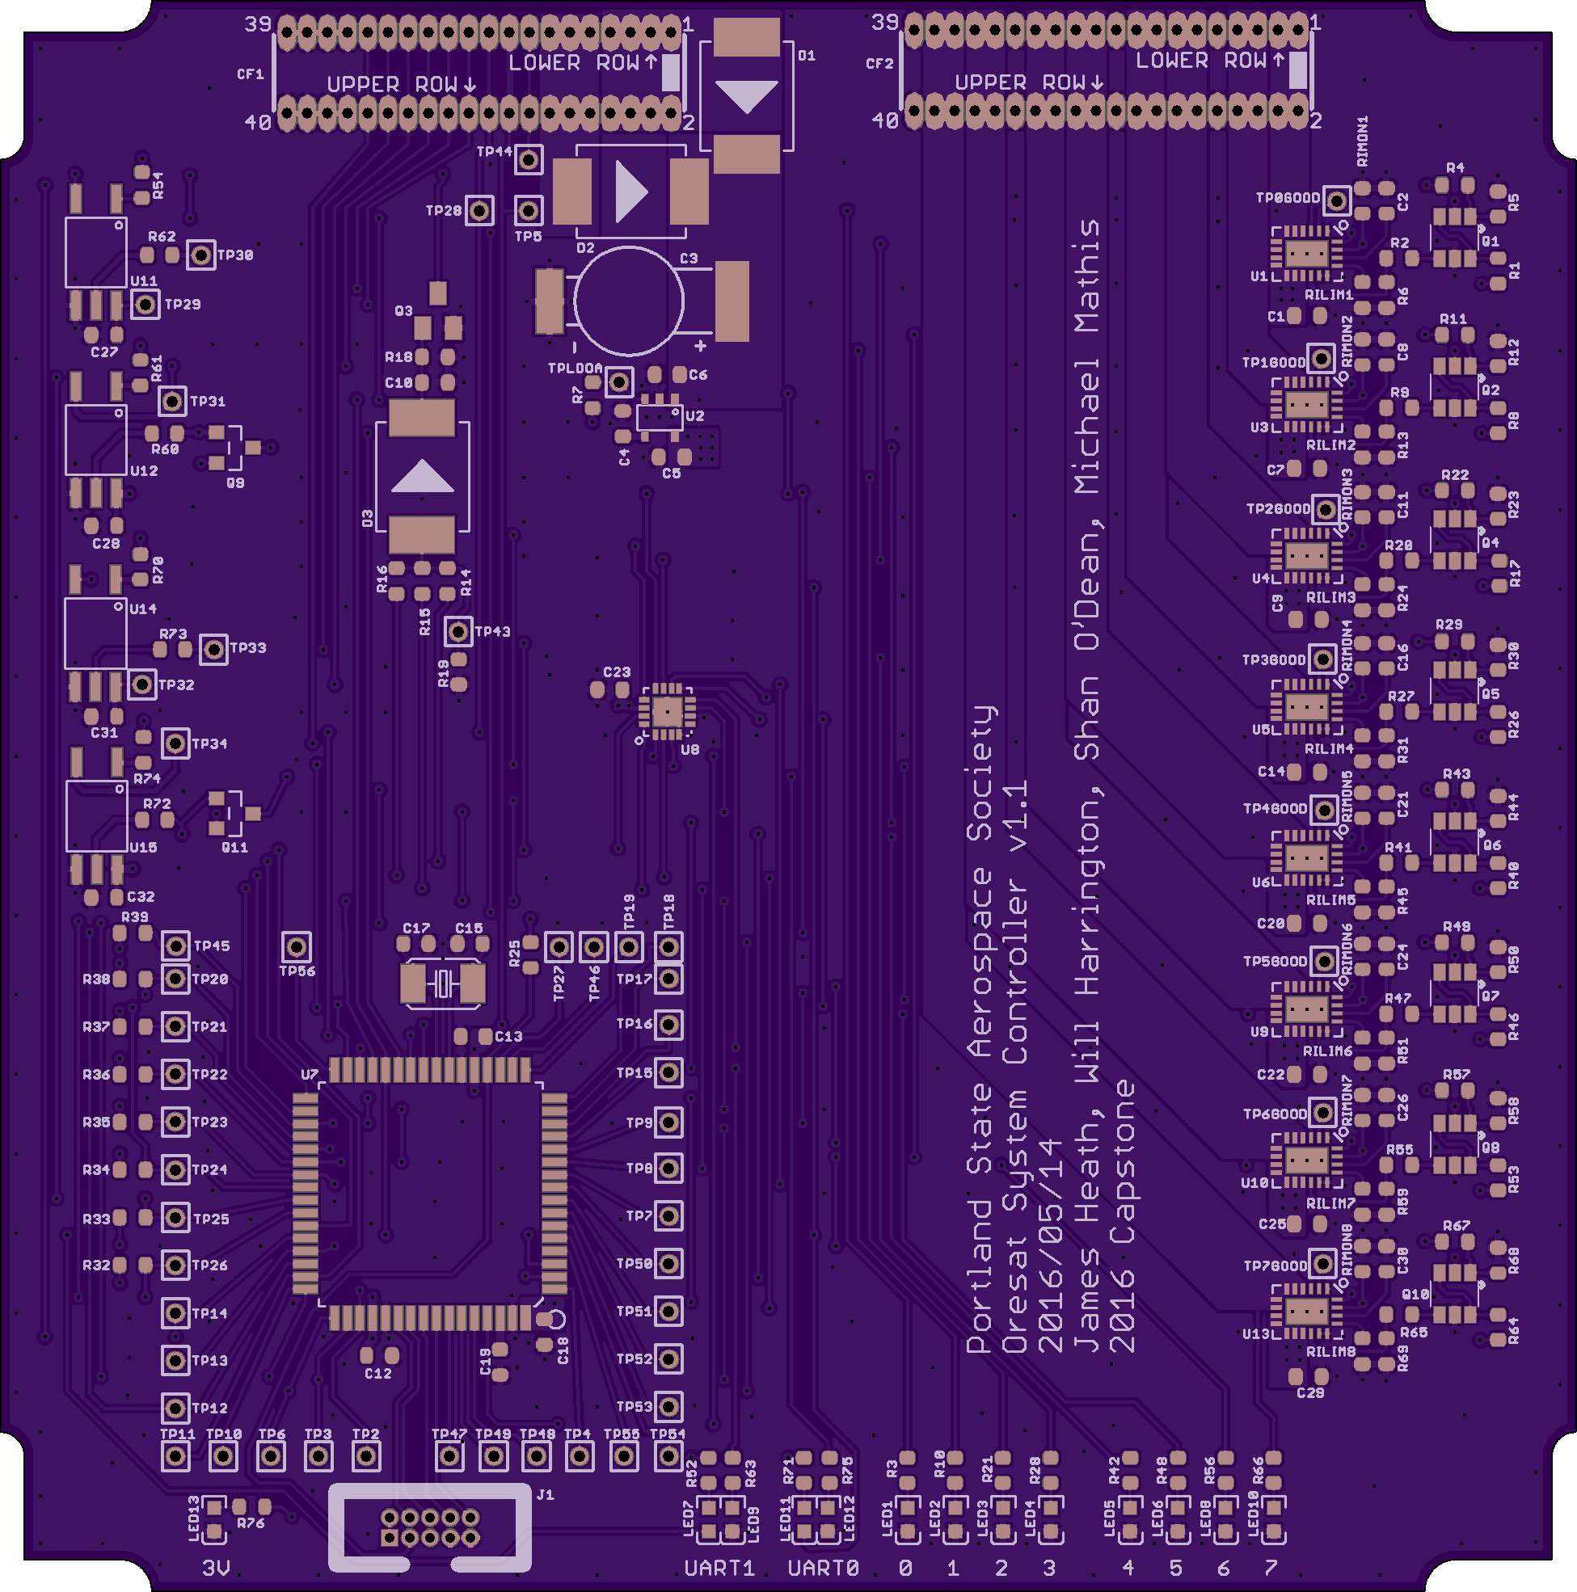

CubeSat Command Control
and Communications System
Project Team:
Will Harrington
Jake Heath
Michael Mathis
Shan Quinney
Special Thanks to:
Andrew Greenberg Theo Hill
Glenn Dr. Teuscher
PSAS The LID
Introduction
Development
Current Results
OreSat requires a robust, long-range command, control, and communication (C3) system to control the satellite. The board must reliably communicate to the ground over 1,400 km (at acquisition of signal) at low data rates (9600 bps) while monitoring and controlling the power system of the satellite
The Portland State Aerospace Society (PSAS) is the lead on the Oregon Small Satellite Project's "OreSat" nanosatellite. OreSat is a CubeSat form-factor nanosatellite designed for a low-earth orbit of 400 km.
Jake Heath working on an LGR module
Layouts of the LGR (left) and the SysCon (right)
Design
Picture of us doing
the 10km test
Graph showing SOMETHING HARDWAREY (left)
Picture of MEMBERS OF TEAM performing a 10km communications test (right)
The Sputnik project is two modules among many included in the OreSat satellite
The Low-Gain Radio (LGR) handles communication and the System Controller (SC) is in charge of command and control for the module.
for the LGR (left) and the SysCon (right)
Pictures of the finished boards LGR (left) and SysCon (right)
Department of Electrical and Computer Engineering

